Slide 2
Size and importance of the pig industry
Cameroon:
A low-income country in Central Africa
Estimated population of over 25.8 million inhabitants
% of households are involved in agriculture 1/3
Proportion agriculturalists involved in pig farming: 23.3%
Has thelargest pig population in Central Africa (Over 3.2 million pigs)
Anual contribution in meat production in Cameroon: 34.556 tons
Pig production in Cameroon is currently estimated to be 2.02 kg/person
lower than the expected 5 kg/person because of numerous diseases (e.g. classical swine fever, swine erysipelas, porcine encephalomyelitis, Pasteurellosis, salmonellosis, ASF etc.) plaguing the livestock industry.

Slide 3
Situation of the ASF in Cameroon
The first-ever ASF outbreak in Cameroon was in 1982 and since then the country has become endemic with a yearly resurgence of the disease
The Ministry has instituted strict sanitary measures and contingency plans to fight against this deadly porcine disease
These measures include:
Reinforcement of epidemiological surveillance in collaboration with the regional delegations for livestock with the national territory
Active control on transportation of pigs from one zone to the other
Sensitization and training of different actors within the pig sector
Sanitary and serological control of pigs from neibouring countries at the different sanitary checkpoints
Active involvement of different zootechnical centres in control

Slide 4
Key challenges faced?
Pig farmers are barely organized
which doesn’t help when aiming to build up proper marketing channels
Certified slaughter or processing facilities are absent
No guarantee quality meat
No space reserved for pig market
Each farmer searches his/her own way for marketing his meat, Therefore each producer is organised as he/she sees fit.”
Minimum of organised trade with neighbouring countries
High feed costs
High disease pressure

Slide 5
ASF research
Distribution of ASF between 2010 and 2017 in the Adamawa, North, and Far North regions of Cameroon (2021) by the Department of Animal Production Technology, College of Technology, University of Bamenda, Bambili, Cameroon.
Determine the knowledge, skills and practices at risk of pig breeders; the prevalence of the disease in piggeries; the genome of the circulating virus (2020 ) School of Veterinary Medicine and Sciences, University of Ngaoundéré.
Molecular Characterization of ASFV in infected Pigs in Production Regions in Cameroon (2022) by the University of Buea in collaboration with the KU Leuven.
Genetic characterization of African swine fever virus in Cameroon, 2010-2018 (2019) by the Department of Microbiology, University de Yaoundé I, Yaoundé, Cameroon.

Slide 6
Title:Molecular Characterization of ASFV in infected Pigs in Production Regions in Cameroon
Presenter: Stephen M. Ghogomu
Country and institution: University of Buea, Cameroon

Slide 7
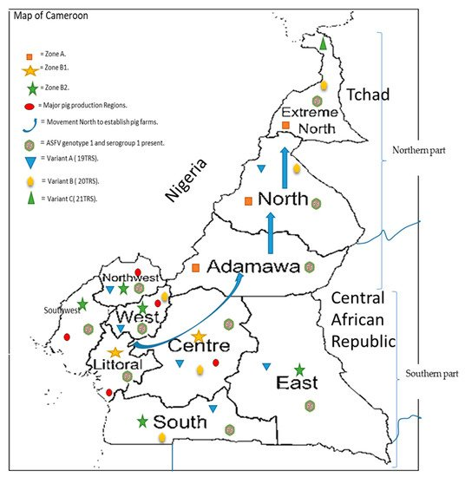
ASFV in Cameroon: What's known
Genotype I
present
Sub group Ia and Ib
Three mainly variants
A, B and C
ASFV
(Domestic cycle)
Ebwanga et al. 2021

Slide 8
Introduction
Many farmers practice free range pig farming: pigs are kept outdoors for their entire life.
This system exposes pigs to various pathogens, including ASFV through contact with neighboring domestic pigs or wild reservoirs
Existence of transboundary movement of live pigs and their products between neighbouring countries through pig trade
It is therefore necessary to identify and characterize:
ASFV strains circulating in Cameroon
ASFVs responsible for new outbreaks and track the disease origin

Slide 9
Objective
To detect and characterize ASFV genetically in domestic pigs suspected to be infected with ASFV from pig production regions in Cameroon.
Findings will:
improve knowledge on the molecular epidemiology of ASFV in Cameroon
Provide additional information for the development of control strategies

Slide 10
Ethical statement
Ethical approval : University of Buea Institutional Animal Care and Use Committee (UB-IACUC)
Regional authorizations: Regional delegations of the different Regions
Consent: Blood was collected only from the pigs of farmers who gave consent for the study
The collection was performed following a standard protocol for jugular vein blood collection in pigs

Slide 11
Study Area
Statistics on 377 samples collected
Collection Site | Region (4) | Division | Farm Location or Slab | Number of Samples Collected | Total
Slaughter slabs (blood and tissue samples) | Southwest | Fako | Mile 16 Buea | 24 | 100
 | Liottoral | Moungo | Grand Hanger market (Bonaberi) | 22
Outbreak collection | Southwest | Fako | `Buea Misselleleh | 30 24
From pig farms (Blood only) | Littoral | Wouri | Bonaberi | 15 | 37
 |  | Moungo | Souza | 22
 | Southwest | Fako | Buea | 69 | 143
 |  |  | Limbe | 26
 |  |  | Misselleleh Area | 48
 | West | Mifi | Baffousam | 8 | 20
 |  | Koung Khi | Baham | 4
 |  |  | Bandjoun | 8
 | Northwest | Mezam | Bafut | 22 | 77
 |  |  | Santa | 55

Slide 12
Methodology
DNA Extraction from blood of sick pigs
Target gene amplification
Detection of virus: presence of the p72 viral capsid protein (257bp band)
120 positives out of 377 samples
prevalence of 31.83%
Genotype detection:
B646L gene (C-terminal) codes for the p72 viral capsid protein (478bp)`
CP204L gene encoding the P30 protein (543bp fragment)
Subgroup identification: E183L gene codes for the p54 viral inner membrane protein (676bp)
Variant determination:
B602L codes for the CVR (358bp)
I173R and I329L intergenic region
Sequencing of the polymorphic loci
Genomic analyses: Comparison of seqs from Cameroon and from Genbank

Slide 13
Genotpe determination: Gene Phylogeny:
Gene | Cluster (%) | No clustering (%) | Remark
B646L (P72) | Genotype I (100) | 0 | Previous results
E183L (P54) | Genotype Ia & Ib (100) | 0 | Previuos results
CP204L (P30) | Genotype I (41.2) | 58.8 | Mostly from Miselele (Exortic breeds)

Slide 14
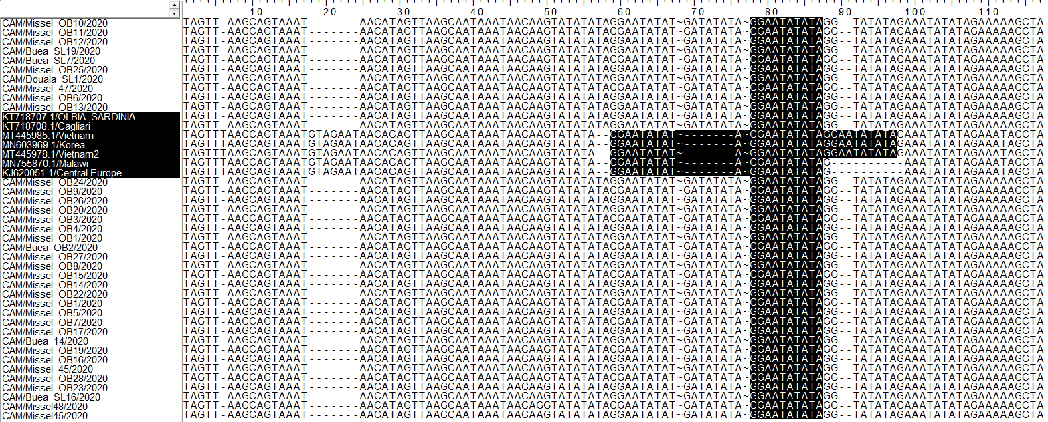
Variant determination: Intergenic region (I73Rand I329L) Phylogeny: One variant (One repeat)
1
3
2
Never effected in Cameroon
1
Single GGAATATATA repeats

Slide 15
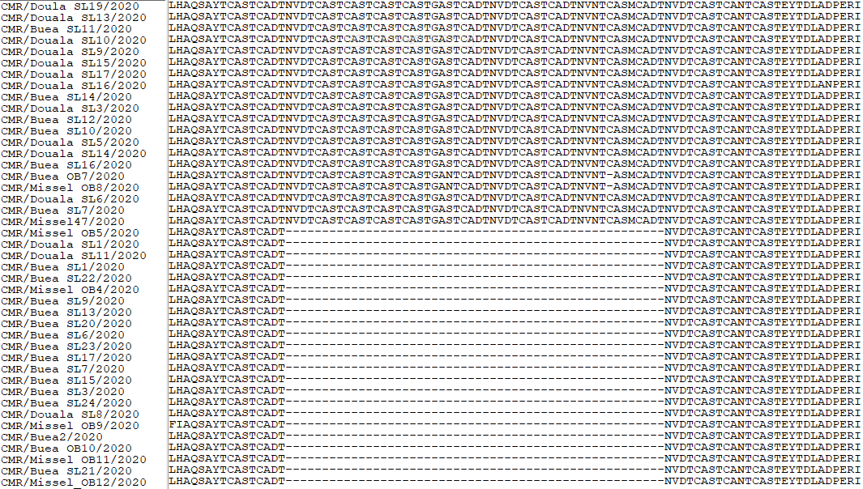
Genotpe determination: BL602L Phylogeny of the CVR: (2 variants: 6 and 9 repeats)
A = CAST | KKK = NLHAQSAYT
B = CADT, CTDT | YYY = EYTDLTDPERIP
D =CASM | F = CANT, CAAT
N = NVDT, NVGT | C = GAST, GANT
V = NAST, NAVT, NANT, NADT | O = NANI, NADI, NASI
S = SAST | H = RAST
a = CVST , CTST, CASI | T = NVNT
J = GTDT | L = YNTN
19
Previous results in Cameroon
Three variants with 19, 20 and 21 repeats
6
LHAQSAYTCASTCADTNVDTCASTCASTCASTCASTGASTCADTNVDTCASTCADTNVNTCASMCADTNVDTCASTCANTFKHRSR
Repeats = ABNAAAACBNABTDBNAF

Slide 16
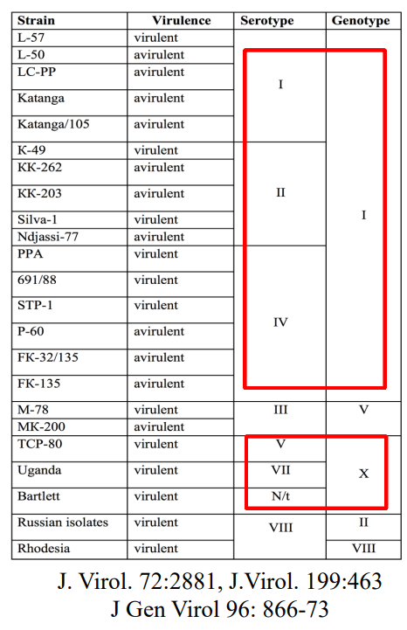
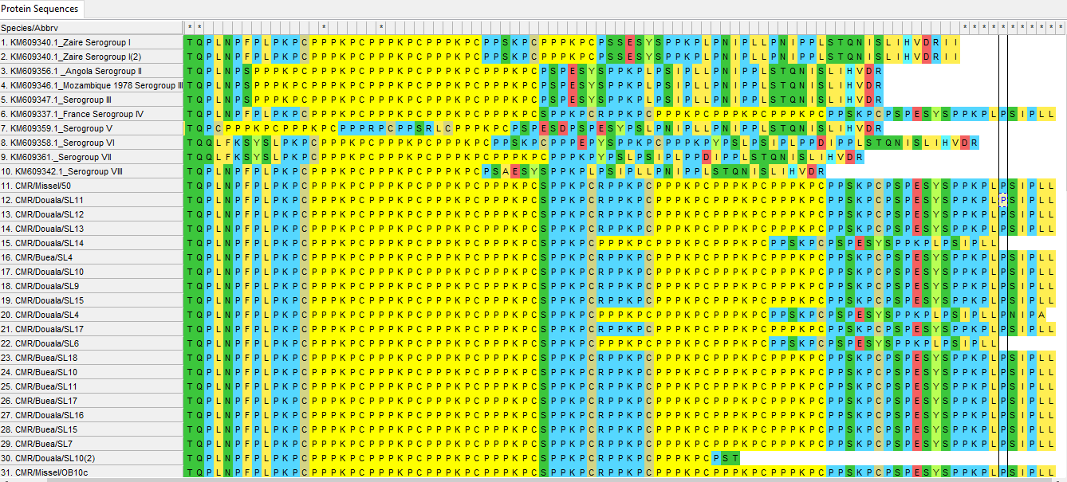
Serogroup determination: Most isolates had 7 PPPKPC repeats one with 5 repeats and a few with 6: Serogroup IV
Previous results in Cameroon
Sero-group I (effected in 1989)
8 serotypes
known

Slide 17
Summary of results
Prevalence : 31,85%
Molecular characterization Previous results in Cameroon
Genotype I
Subgroup Ia
CP204L gene : 41.2% into genotype I and 58.8 out
Two variants : 19 and 6 repeats
Sero-group I: 97.30% ( 7 PPPKPC repeats)
I173R and I329L : Single GGAATATATA repeat (One variant)
Genotype I
Subgroup Ia and Ib
Never effected
Three variants with 19,20 and 21
Sero-group I
Never effected

Slide 18
Conclusion
There is need for persistent molecular characterization to:
i). Improve knowledge on molecular epidemiology of ASFV in Cameroon
ii). Provide additional information for the development of control strategies

Slide 19
Thank you for your Kind attention

Slide 21
What is your vision for the swine sector in your country for the next 5 years/10 years?
Research into vaccine development either attenuated or sub-unit vaccines must have been developed
The search for host genes related to protection in the case of the local and the wild suids must have been developed
Strategies must have been developed to track outbreaks especially when they are not reported
The transfer of sera from the recovered local or exotic breeds to naïve animals.

Slide 22
What are your 3 – 5 expectations from this ASF GAP Analysis?
The meeting is well organized
I should be able to learn new research ideas on the control of ASF
Establishment of new research collaborations and teams
Scrupulous time management

